Slide 1
Naming in Distributed Systems
Mercy Maina

Slide 2
Introduction
Names play a very important role in all computer systems.
They are used to share resources, to uniquely identify entities, to refer to locations, and more.
An important issue with naming is that a name can be resolved to the entity it refers to.
Naming in distributed systems provides a way to identify and locate resources
Implementation of a naming system is itself often distributed across multiple machines

Slide 3
Key Concepts in Distributed Naming
Entity: Any resource (e.g., host, Server, printer, file, serverless function) requiring identification
Name: A string of bits or characters that is used to uniquely identify, locate, and access resources (entities
Name System: foundational mechanisms that assign, resolve, and manage identifiers (names) for resources like files, services, and nodes.
Name Service: Mechanism that provides a consistent, uniform, and human-readable way to identify and locate resources (e.g., servers, files, users) across a network, mapping these names to system-internal identifiers like IP addresses.
Address: The name of the access point to an entity. It is used to locate and it enables an entity to be operated.

Slide 4
Key concepts …../2
6. Identifier: A unique name for an entity that does not change.
7. Name Space: A graph consisting of directory nodes (grouping names) and leaf nodes (representing resources).
8. Name Server: Stores the bindings between names and network addresses.
9. Name Resolution: The process of mapping a name to the entity's address or identifier.
10. Resolution Process: The mechanism by which a client follows paths through the name space to find the target.
11. Reverse Name Resolution: Translating an address back into a human-readable name.

Slide 5
Name Service
Aims to provide a consistent and uniform naming of resources
Purpose
  Name Resolution:
    Recursive:.
    Iterative:
  Publish-Subscribe systems:
  Named Spaces:
  Stores Attributes and Bindings:
  Caching: enables resource location, sharing, and lookup across a network
Benefits
  Resource localization
  Uniform naming
  Device independent address

Slide 6
Name System
Concrete, hierarchical network infrastructure that implements name service. Provides the storage and lookup mechanism.
Importance
  Resource Identification and Access:
  Location Transparency and Independence:
  Scalability:
  Support for Mobility:
  Name Resolution:
  Simplified Communication:
  Fault Tolerance:
  Security
  User-Friendly:
  Efficiency:

Slide 7
Naming Schema in Distributed Systems
Rules by which names are given to individual entities
  critical role in resource identification and location
  abstract the complexity of resource management and enable seamless interaction between components, regardless of their location or underlying infrastructure.
Types
  Flat Naming / Simple Schema:
  Structured Naming / Hierarchical Naming:
  Attribute-Based Naming:

Slide 8
Flat Naming / Simple Naming
Features
  Unique Identifiers:
  Simplicity:
  Flexibility:
  Decentralization:
  Scalability:
  Avoids Bottlenecks:
  Lack of Structure:
  Name Resolution Approaches:
  Scalability & Performance

Slide 9
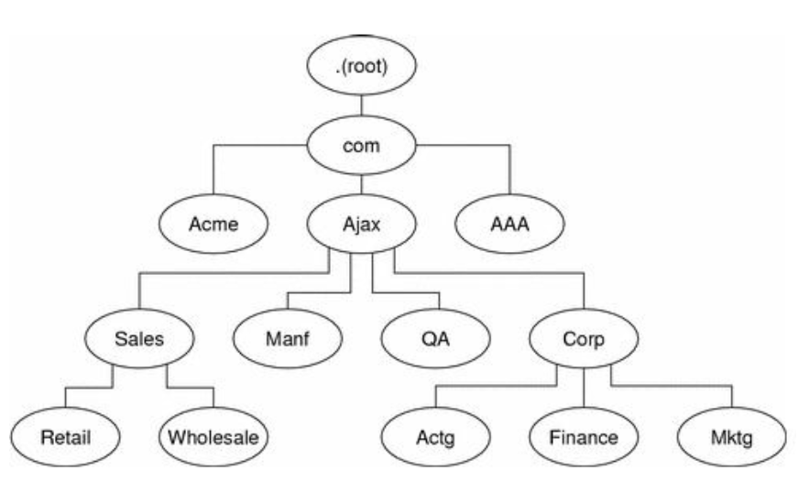
Structured / Hierarchical Naming
Introduces a hierarchical structure to the names of objects or entities
Example
  DNS – Domain Name System,
  LDAP - Lightweight Directory Access Protocol
  Distributed file system

Slide 10
Structured Naming ……. /2
Key Concepts
  Hierarchy Structure: e.g., /home/user/file or sub.example.com).
  Graph-Based Namespace:
  Name Resolution:
  Directory Nodes:
  Separation of Duties:
  Path Names:
Benefits
  Human-Readable: Easier to remember than numerical IP addresses.
  Scalability:
  Flexibility:
  Allows for easier organization, navigation, and identification of objects.
  It also provides a clear relationship between objects within the hierarchy
  Scalability
  Efficient Lookup and management

Slide 11
Attribute – Based Naming
Assigns names to objects based on their specific attributes or characteristics.
Uses descriptive attributes to uniquely identify objects (location = floor2, Type = printer)
Key Concepts
  Attributes: Describe aspects of the entity, including type, location, or owner.
  Directory Service: A distributed database or registry that stores these descriptions. - "phonebook" for IT environments,
  Flexible Querying: Enables partial matches and complex queries, unlike rigid hierarchical naming systems.
  Search Capabilities
  Identifiers:

Slide 12
Naming – Design Requirements
Location Transparency: The name does not reveal the physical location of the entity.
Location Independence: An entity's name does not change when its location changes.
Scalability: Naming systems must handle large numbers of entities and lookups.
Caching: Improves performance by storing frequently used name-to-address mappings.

Slide 13
Name Resolution
Process of mapping human-readable, logical names (e.g., URL or service name) to physical network addresses (e.g., IP addresses) to locate resources, files, or services.
Referred to as Domain Name System (DNS) lookup
Components
  Name Space: A graph consisting of directory nodes (grouping names) and leaf nodes (representing resources).
  Name Server: Stores the bindings between names and network addresses.
  Resolution Process: The mechanism by which a client follows paths through the name space to find the target.
  Reverse Name Resolution

Slide 14
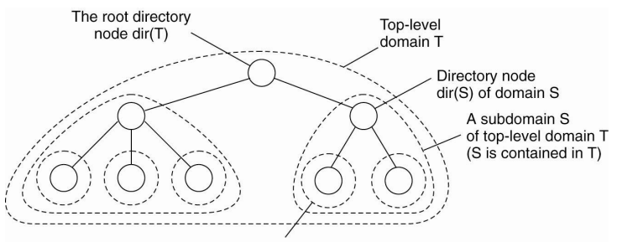
Domain Name System (DNS) - Lookup
DNS Resolver: Initiates the lookup process. Also called a DNS client.
Recursive Query: Resolver queries multiple servers on behalf of the client until the IP is found.
Iterative Query: Resolver asks servers for the best answer available.
Non-Recursive Query: Resolver queries a server that already has the record in its cache

Slide 15
Domain Name System (DNS) LookUp …../2
Process
  User Input: You enter a website address (for example, www.geeksforgeeks.org) into your web browser.
  Local Cache Check: - recently looked up or not?
  DNS Resolver Query: receives the request if step 2 is negative
  Root DNS Server: The resolver sends the request to a root DNS server. – Top Level Domain (TLD)
  TLD Server: directs the resolver to the authoritative DNS server for the Website address
  Authoritative DNS Server: sends the IP address back to the resolver.
  Final Response: The DNS resolver sends the IP address to your computer, allowing it to connect to the website’s server and load the page.

Slide 16
Reverse DNS Lookup
Reverse DNS Lookup is the process of mapping an IP address back to its corresponding domain name.
Commonly used for:
  Network Diagnostics: System administrators use reverse DNS to determine the domain name associated with a specific IP address. This helps identify the source of network traffic.
  Email Security: Many email servers perform reverse DNS lookups to verify that incoming emails are coming from legitimate sources. This helps prevent spam and fraud.

Slide 17
Questions & Answers
End

